Slide 1
Run-Time Environment Lecture 13

Slide 2
Run-time Environment
Compiler must cooperate with OS and other system software to support implementation of different abstractions (names, scopes, bindings, data types, operators, procedures, parameters, flow-of-control) on the target machine
Compiler does this by Run-Time Environment in which it assumes its target programs are being executed
Run-Time Environment deals with
Layout and allocation of storage
Access to variable and data
Linkage between procedures
Parameter passing
Interface to OS, I/O devices etc

Slide 3
Storage Organization
Compiler deals with logical address space
OS maps the logical addresses to physical addresses
Memory locations for code are determined at compile time. Usually placed in the low end of memory
Size of some program data are known at compile time – can be placed another statically determined area
Dynamic space areas – size changes during program execution.
Heap
Grows towards higher address
Stores data allocated under program control
Stack
Grows towards lower address
Stores activation records
Typical subdivision of run-time memory
Code
Static
Heap
Free Memory
Stack

Slide 4
Run-Time Environments
How do we allocate the space for the generated target code and the data object of our source programs?
The places of the data objects that can be determined at compile time will be allocated statically.
But the places for the some of data objects will be
allocated at run-time.
The allocation and de-allocation of the data objects is managed by the run-time support package.
run-time support package is loaded together with the generated target code.
the structure of the run-time support package depends on the semantics of the programming language (especially the semantics of procedures in that language).

Slide 5
Procedure Activations
Each execution of a procedure is called as activation of that procedure.
An execution of a procedure P starts at the beginning of the procedure body;
When a procedure P is completed, it returns control to the point immediately after the place where P was called.
Lifetime of an activation of a procedure P is the sequence of steps between the first and the last steps in execution of P (including the other procedures called by P).
If A and B are procedure activations, then their lifetimes are either non-overlapping or are nested.
If a procedure is recursive, a new activation can begin before an earlier activation of the same procedure has ended.

Slide 6
Call Graph
A call graph is a directed multi-graph where:
the nodes are the procedures of the program and
the edges represent calls between these procedures.
Used in optimization phase.
Acyclic € no recursion in the program Can be computed statically.

Slide 7
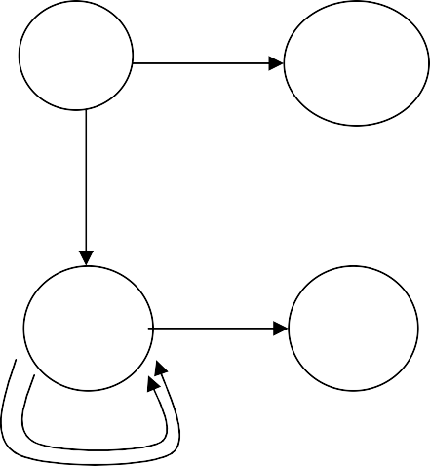
Example: Call Graph
var a: array [0 .. 10] of integer;
procedure readarray var i: integer begin … a[i] … end
function partition(y,z: integer): integer var i,j,x,v: integer begin … end
procedure quicksort(m,n: integer) var i: integer begin i := partition(m,n); quicksort(m,i-1); quicksort(i+1,n) end
Main
readarray
quicksort
partition
procedure main
begin readarray(); quicksort(1,9); end

Slide 8
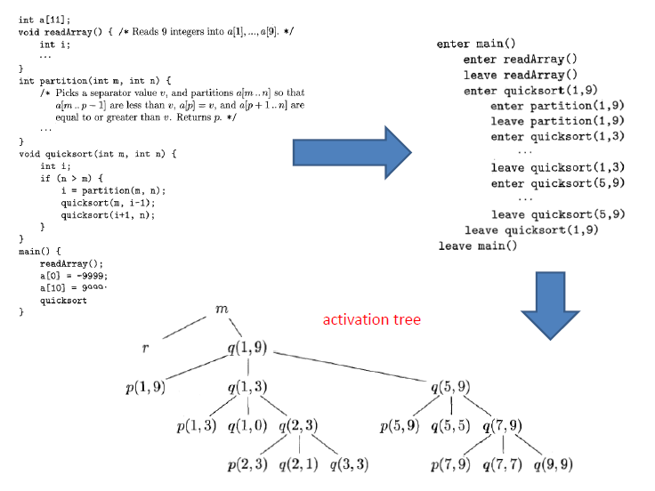

Slide 9
Example: Call Graph
void Output(int n, int x){
printf(“The value of %d! is %d.\n”,n,x);
}
int Fat(int n){
int x;
if(n > 1)
x = n * Fat(n-1);
else
x = 1;
Output(n,x);
return x;
}
void main(){
Fat(4);
}

Slide 10
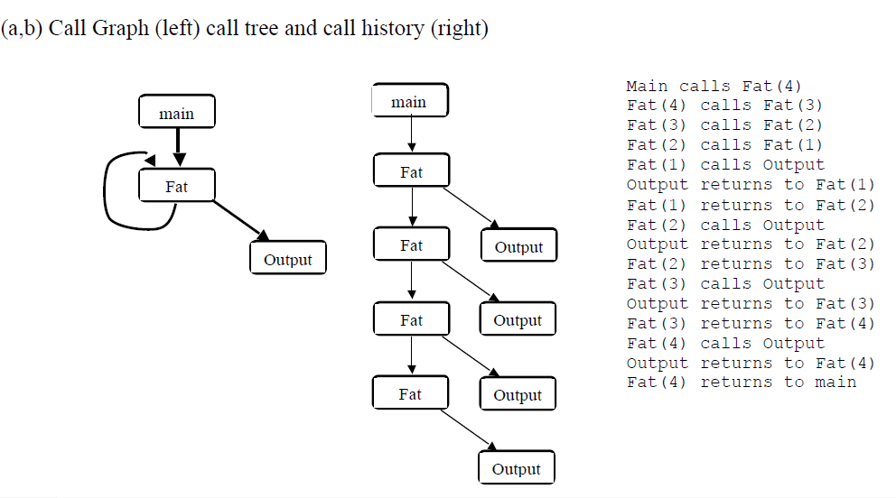

Slide 11
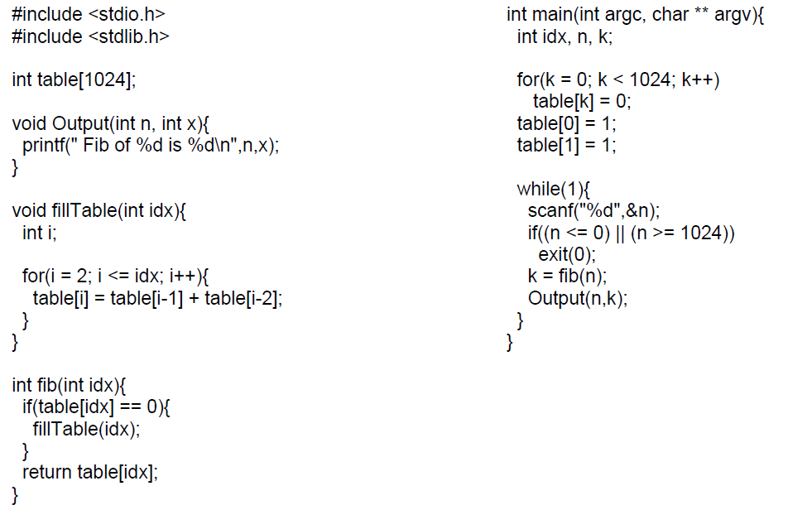

Slide 12
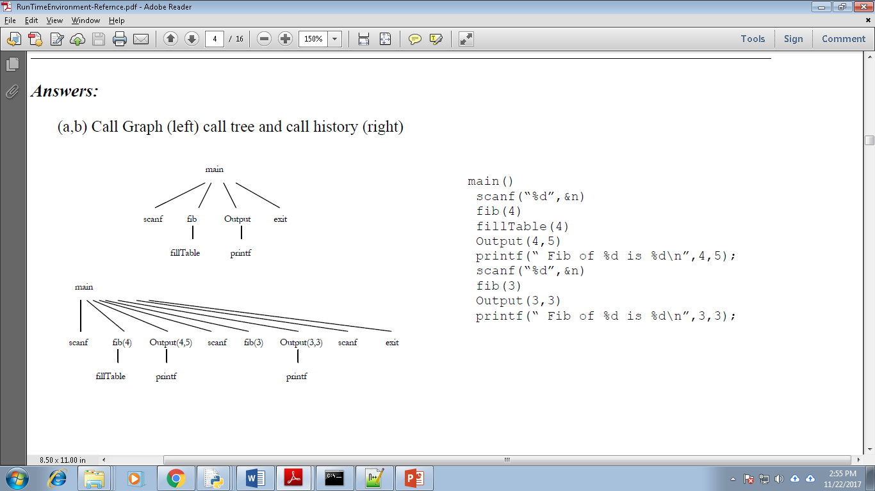

Slide 13
Implementing Run-time control flow
Procedure call/return – when a procedure activation terminates, control returns to the caller of this procedure.
Parameter/return value – values are passed into a procedure activation upon call. For a function, a value may be returned to the caller.
Variable addressing – when using an identifier, language scope rules dictate the binding.

Slide 14
Static Allocation
Historically, the first approach to solve the run-time control flow problem (Fortran)
All space allocated at compile time
Code area – machine instructions for each procedure
Static area / procedure call frame/ activation record
single data area allocated for each procedure.
– local vars, parameters, return value, saved registers
return address for each procedure.

Slide 15
Static Allocation
Data area
for procedure A
Data area
for procedure B
Code area
Code generated for A
return addr
return addr
Local data,
parameters, return value, registers for B
Local data, parameters,
return value, registers for A
Code generated for B

Slide 16
Call/Return processing in Static Allocation
When A calls B:
in A: evaluate actual parameters and place into B’s data area, place RA in B’s data area, save any registers or status data needed, update the program counter (PC) to B’s code
When the call returns
in B: move return value to known place in data area, update PC to value in RA
in A: get return value, restore any saved registers or status data

Slide 17
Static Allocation
Call tree: A
Code area
Activation for procedure A
Activation for procedure B
A:
PC
call B L1:
B:
… return
Local data, parameters,
return value, registers for A
Local data,
parameters, return value, registers for B

Slide 18
Static Allocation
Call tree: A
Code area
Activation for procedure A
Activation for procedure B
B
A:
PC
call B L1:
L1
B:
… return
Local for A
data
Local data for B

Slide 19
Static Allocation
Call tree: A
Code area
Activation
Activation
A:
 | for pro A | cedure |  | for procedure B
 |  |  |  | L1
 | Local for A | data |  | Local data for B
PC
call B L1:
B:
… return

Slide 20
Static Allocation: Recursion?
Code area
A:
call B
Activation for procedure A
Activation for procedure B
return addr
Local data for B
return addr
B:
Local for A
data
call B L2:
What happens???

Slide 21
Static Allocation: Recursion
Call tree: A
Code area
Activation for procedure A
Activation for procedure B
A:
call B L1:
PC
B:
call B L2:
return
Local for A
data
Local data for B

Slide 22
Static Allocation: Recursion
Call tree: A
Code area
Activation for procedure A
Activation for procedure B
B
A:
call B L1:
PC
L1
B:
call B L2:
return
Local for A
data
Local data for B

Slide 23
Static Allocation: Recursion
Call tree: A
Code area
Activation for procedure A
Activation for procedure B
B
A:
call B L1:
PC
B
L2
B:
call B L2:
return
Local for A
data
Local data for B

Slide 24
Static Allocation: Recursion
Call tree: A
Code area
Activation for procedure A
Activation for procedure B
B
A:
call B L1:
PC
L2
B:
call B L2:
return
Local for A
data
Local data for B

Slide 25
Static Allocation: Recursion
Call tree: A
Code area
Activation for procedure A
Activation for procedure B
B
A:
call B L1:
PC
L2
We’ve lost the L1 label so we can’t
get back to A
B:
call B L2:
return
Local for A
data
Local for B
data

Slide 26
Variable addresses hard-coded, usually as offset from data area where variable is declared.
addr(x) = start of x's local scope + x's offset
Runtime Addressing in Static Allocation

Slide 27
Stack Allocation
Need a different approach to handle recursion.
Code area – machine code for procedures
Static data – often not associated with procedures
Stack (Control Stack) – runtime information

Slide 28
Control Stack
The flow of the control in a program corresponds to a depth-first traversal of the activation tree that:
starts at the root,
visits a node before its children, and
recursively visits children at each node an a left-to-right order.
A stack (called control stack) can be used to keep track of live procedure activations.
An activation record is pushed onto the control stack as the activation starts.
That activation record is popped when that activation ends.
Dynamic – grows and shrinks
When node n is at the top of the control stack, the stack contains the nodes along the path from n to the root.

Slide 29
Activation Records
Information needed by a single execution of a procedure is managed using a contiguous block of storage called activation record.
An activation record is allocated when a procedure is entered, and it is de-allocated when that procedure exited.
Size of each field can be determined at compile time (Although actual location of the activation record is determined at run-time).
– Except that if the procedure has a local variable and its size depends on a parameter, its size is determined at the run time.

Slide 30
Activation Trees
A program is a sequence of instructions combined into a number of procedures. Instructions in a procedure are executed sequentially. A procedure has a start and an end delimiter and everything inside it is called the body of the procedure. The procedure identifier and the sequence of finite instructions inside it make up the body of the procedure.
The execution of a procedure is called its activation. An activation record contains all the necessary information required to call a procedure. An activation record may contain the following units (depending upon the source language used).
Whenever a procedure is executed, its activation record is stored on the stack, also known as control stack. When a procedure calls another procedure, the execution of the caller is suspended until the called procedure finishes execution. At this time, the activation record of the called procedure is stored on the stack.
We assume that the program control flows in a sequential manner and when a procedure is called, its control is transferred to the called procedure. When a called procedure is executed, it returns the control back to the caller. This type of control flow makes it easier to represent a series of activations in the form of a tree, known as the activation tree.

Slide 31
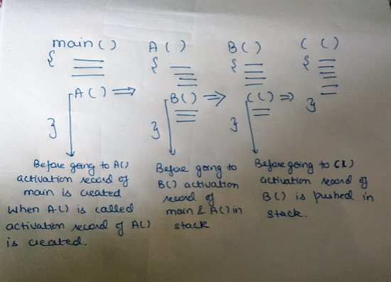
CONTROL STACK AND ACTIVATION RECORDS
Control stack or runtime stack is used to keep track of the live procedure activations i.e the procedures whose execution have not been completed. A procedure name is pushed on to the stack when it is called (activation begins) and it is popped when it returns (activation ends). Information needed by a single execution of a procedure is managed using an activation record or frame. When a procedure is called, an activation record is pushed into the stack and as soon as the control returns to the caller function the activation record is popped.

Slide 32
Activation Records (cont.)
The returned value of the called procedure is returned
in this field to the calling procedure. In practice, we may use a machine register for the return value.
The field for actual parameters is used by the calling procedure to supply parameters to the called procedure.
The optional control link points to the activation record of the caller.
The optional access link is used to refer to nonlocal data held in other activation records.
The field for saved machine status holds information about the state of the machine before the procedure is called.
The field of local data holds data that local to an execution of a procedure..
Temporary variables is stored in the field of temporaries.
return value
actual parameters
optional control link
optional access link
saved machine status
local data
temporaries

Slide 33
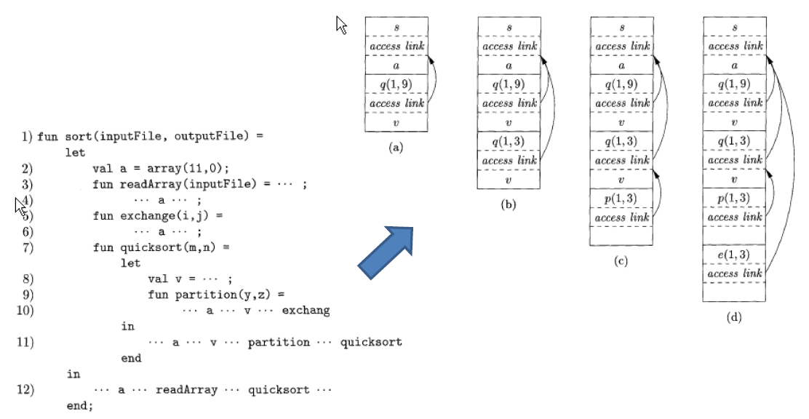

Slide 34
Activation Records (Ex1)
stack
main
p a:
q b:
program main; procedure p;
var a:real; procedure q;
var b:integer;
begin ... end; begin q; end;
procedure s;
var c:integer; begin ... end; begin p; s; end;
main
p
s
q

Slide 35
Activation Records for Recursive Procedures
program main; procedure p;
function q(a:integer):integer; begin
if (a=1) then q:=1;
else q:=a+q(a-1); end;
begin q(3); end; begin p; end;
main
p
a: 3 | q(3)
a:2 | q(2)
a:1 | q(1)

Slide 36
Stack Allocation for quicksort 1
Call Tree
Main readarray
Stack (growing downward)
Main
a: array
readarray
i: integer

Slide 37
Stack Allocation for quicksort 2
Call Tree
Main readarray quick(1,9)
Stack (growing downward)
Main
a: array
quick(1,9)
i: integer

Slide 38
Stack Allocation for quicksort 3
Call Tree
Main readarray quick(1,9)
Stack (growing downward)
Main
a: array
quick(1,9)
i: integer
quick(1,3)
i: integer
quick(1,0)
i: integer
p(1,9)
quick(1,3)
p(1,9)
quick(1,0)

Slide 39
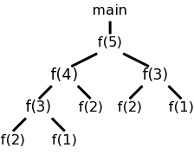
Activation Trees
System starts main int a[10];
enter f(5) int main(){
enter f(4) int i;
enter f(3) for (i=0; i<10; i++){
enter f(2) a[i] = f(i);
exit f(2) }
enter f(1) }
exit f(1) int f (int n) {
exit f(3) if (n<3) return 1;
enter f(2) return f(n-1)+f(n-2);
exit f(2) }
exit f(4)
enter f(3)
enter f(2)
exit f(2)
enter f(1)
exit f(1)
exit f(3)
exit f(5)
main ends

Slide 40
Activation Trees
main(){
Int n;
readarray();
quicksort(1,n);
}
quicksort(int m, int n){
Int i= partition(m,n);
quicksort(m,i-1);
quicksort(i+1,n);
}
Properties of activation trees are :-
1. Each node represents an activation of a procedure.
2. The root shows the activation of the main function.
3. The node for procedure ‘x’ is the parent of node for procedure ‘y’ if and only if the control flows from procedure x to procedure y.

Slide 41
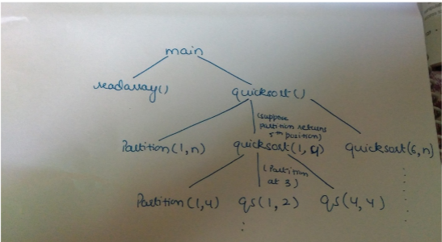
Activation Trees
First main function as root then main calls readarray and quicksort. Quicksort in turn calls partition and quicksort again. The flow of control in a program corresponds to the depth first traversal of activation tree which starts at the root.

Slide 42
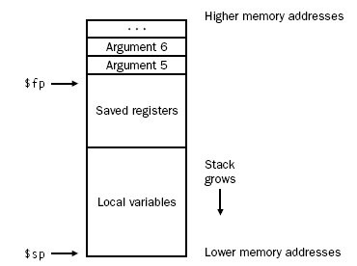
Layout of the stack frame
Frame pointer $fp: points to the first word of the frame,
Stack pointer ($sp): points to the last word of the frame.
The frame consists of
the memory between locations pointed by
$fp and $sp

Slide 43
Creation of An Activation Record
Who allocates an activation record of a procedure?
Some part of the activation record of a procedure is created by that procedure immediately after that procedure is entered.
Some part is created by the caller of that procedure before that procedure is entered.
Who deallocates?
Callee de-allocates the part allocated by Callee.
Caller de-allocates the part allocated by Caller.

Slide 44
Creation of An Activation Record (cont.)
return value
actual parameters
optional control link
optional access link
saved machine status
local data
temporaries
Caller’s Activation Record
Caller’s Responsibility
Callee’s Activation Record
return value
actual parameters
optional control link
optional access link
saved machine status
local data
temporaries
Callee’s Responsibility

Slide 45
Storage and access for locally declared data
The executing procedure uses the frame pointer to quickly access values in its stack frame as the frame pointer points to the start of the frame.
Then add the variable’s offset from the start of the frame. Calculating local data’s offset (to be stored in the symbol table)
However problem arise for variable length data

Slide 46
Variable-Length Local Variables
Goal:
Allow a routine to have variable-length data
(i.e., dynamically-sized arrays) as local data in frame
Option 1:
Allocate the variable on the heap Work with pointers to the data
Auto free the data when the routine returns
Option 2:
Create the variable on the stack, dynamically Effectively: Enlarge the frame as necessary Still need to work with pointers

Slide 47
Variable Length Data
return value
actual parameters
optional control link
optional access link
saved machine status
local data pointer a pointer b
temporaries
array a array b
Activation record
for p
Control link and saved status
……… Pointer to a Pointer to b
….
Array a
Array b
Arrays
of p
Activation
record for q
top_sp
Control link and saved status
Arrays
of q
top
Variable length data is allocated after temporaries, and there is a link to from local data to that array.

Slide 48
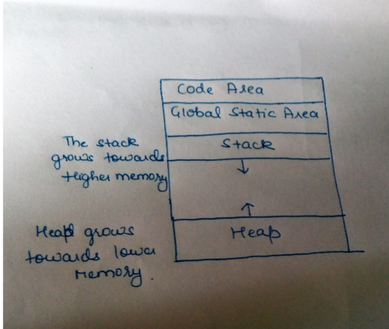
SUBDIVISION OF RUNTIME MEMORY
Runtime storage can be subdivide to hold :
Target code- the program code , it is static as its size can be determined at compile time
Static data objects
Dynamic data objects- heap
Automatic data objects- stack

Slide 49
STORAGE ALLOCATION TECHNIQUES
I. Static Storage Allocation
For any program if we create memory at compile time, memory will be created in the static area.
For any program if we create memory at compile time only, memory is created only once.
It don’t support dynamic data structure i.e memory is created at compile time and deallocated after program completion.
The drawback with static storage allocation is recursion is not supported.
Another drawback is size of data should be known at compile time
Eg- FORTRAN was designed to permit static storage allocation.
II. Stack Storage Allocation
Storage is organised as a stack and activation records are pushed and popped as activation begin and end respectively. Locals are contained in activation records so they are bound to fresh storage in each activation.
Recursion is supported in stack allocation
III. Heap Storage Allocation
Memory allocation and deallocation can be done at any time and at any place depending on the requirement of the user.
Heap allocation is used to dynamically allocate memory to the variables and claim it back when the variables are no more required.
Recursion is supported.

Slide 50
Reference
https://www.youtube.com/watch?v=2z50z25ygLg&list=PLO9y7hOkmmSFj91O7ZM-Im_5107nLLnGQ&index=2

Slide 51
Thank you

